Slide 1

Homepage Menu Design
MaidEase

Slide 2
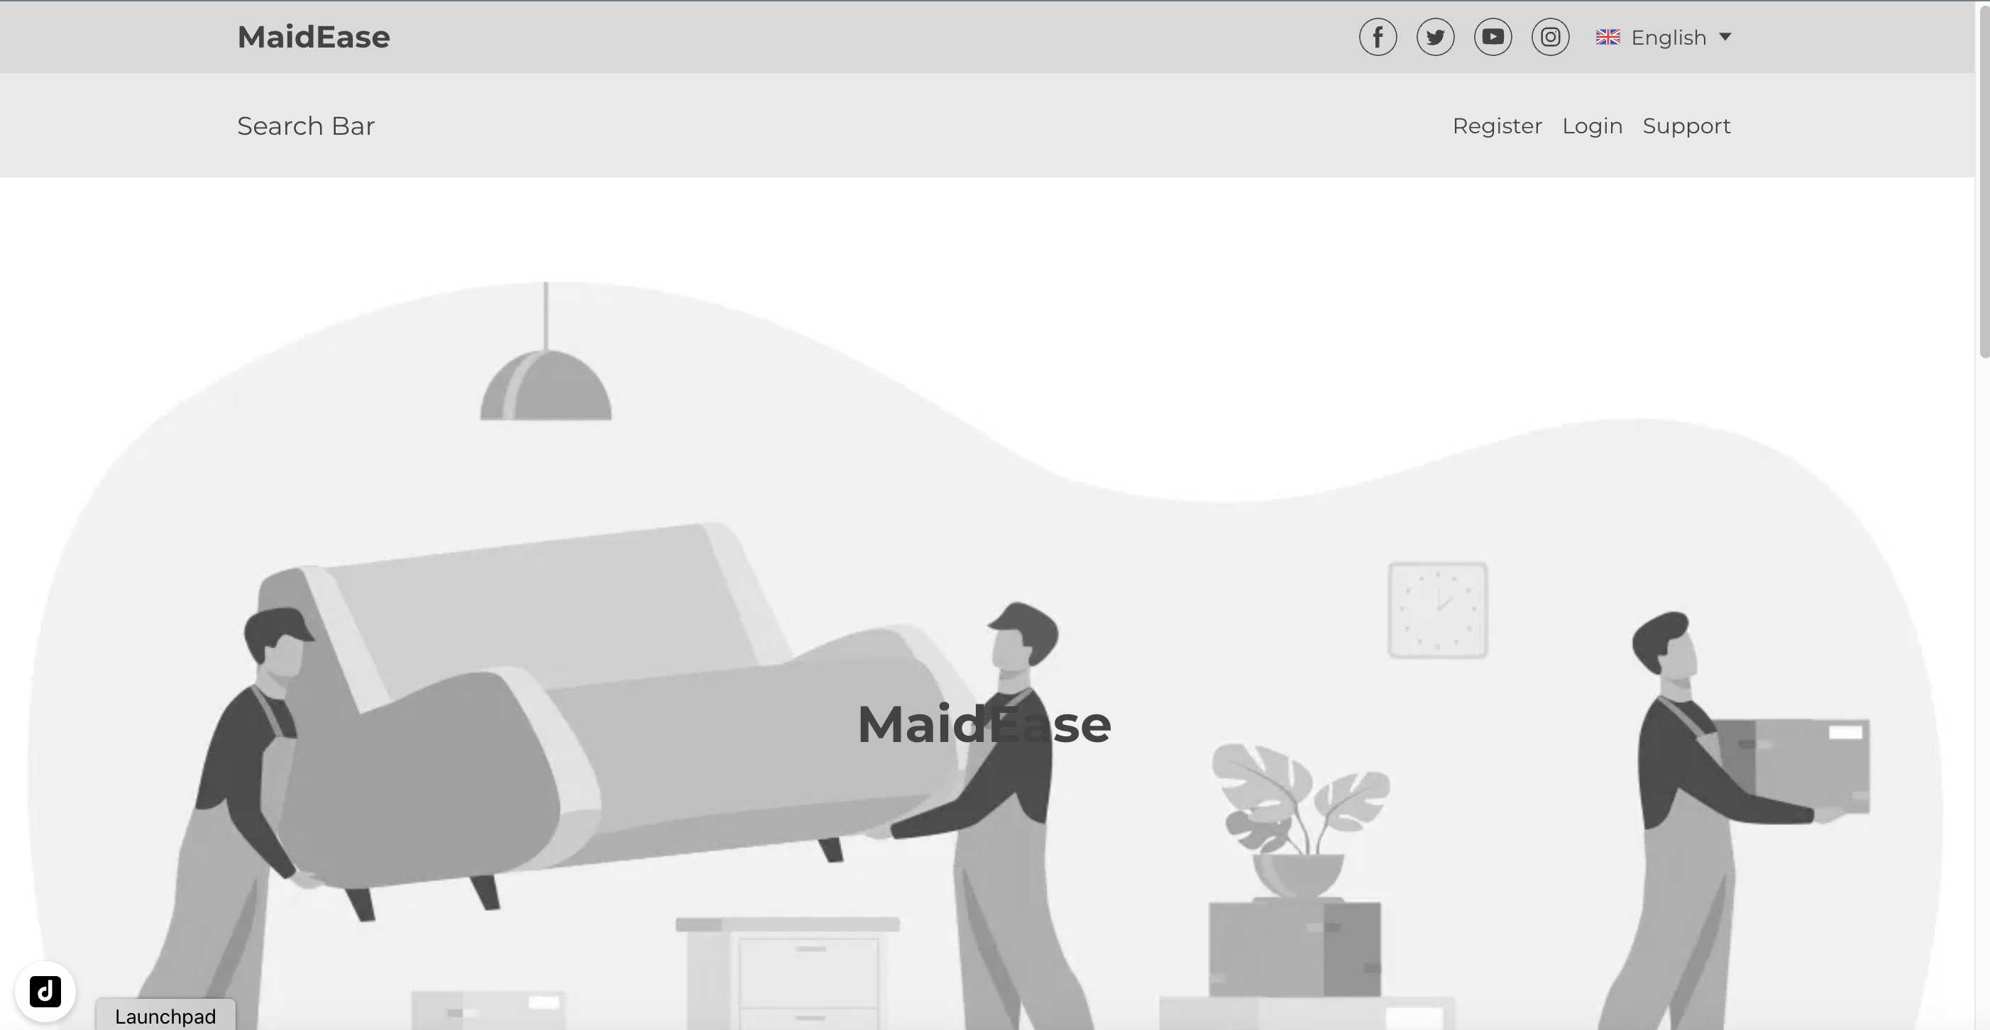
Homepage Menus
Register
Login
Support

Slide 3
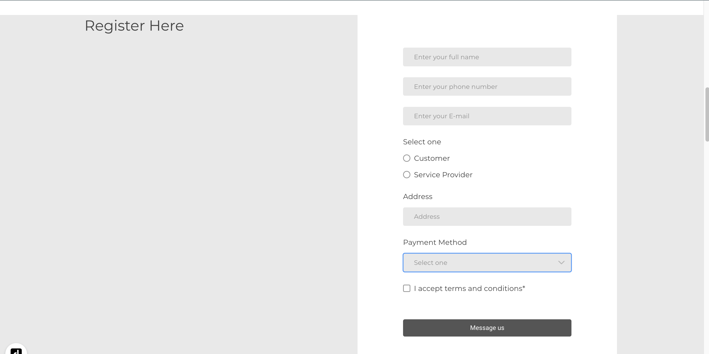
Register

Slide 4
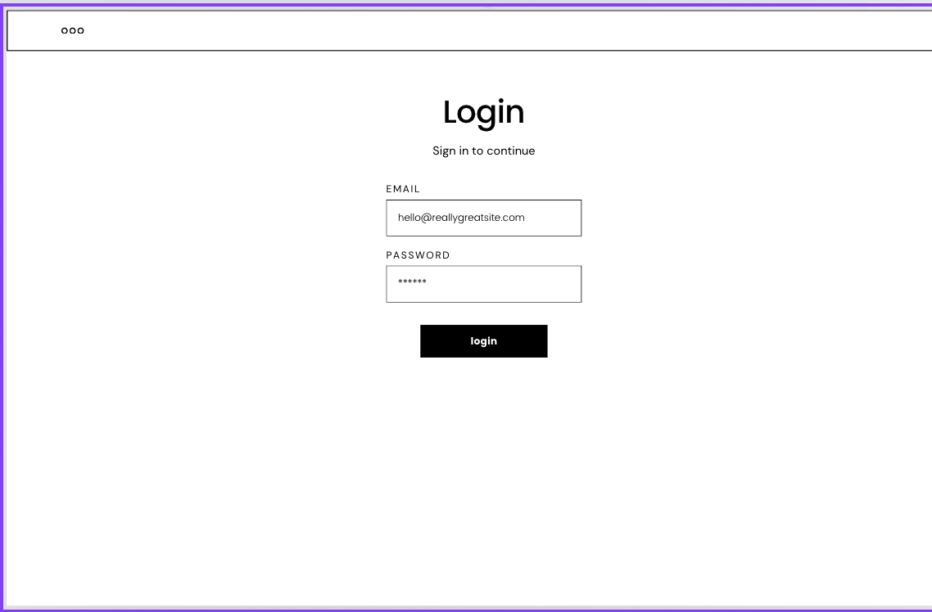
Login

Slide 5
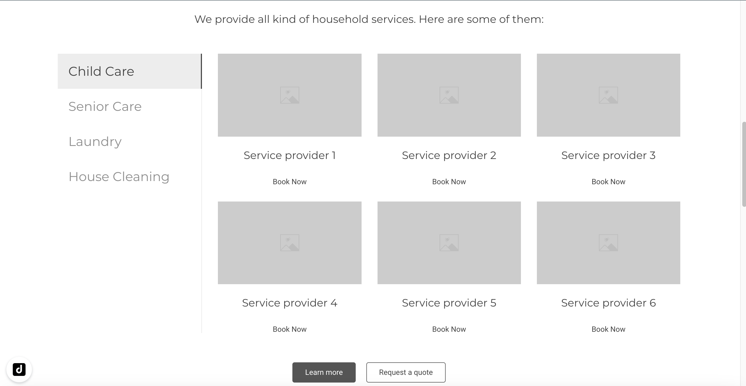
Customer’ Dashboard

Slide 6
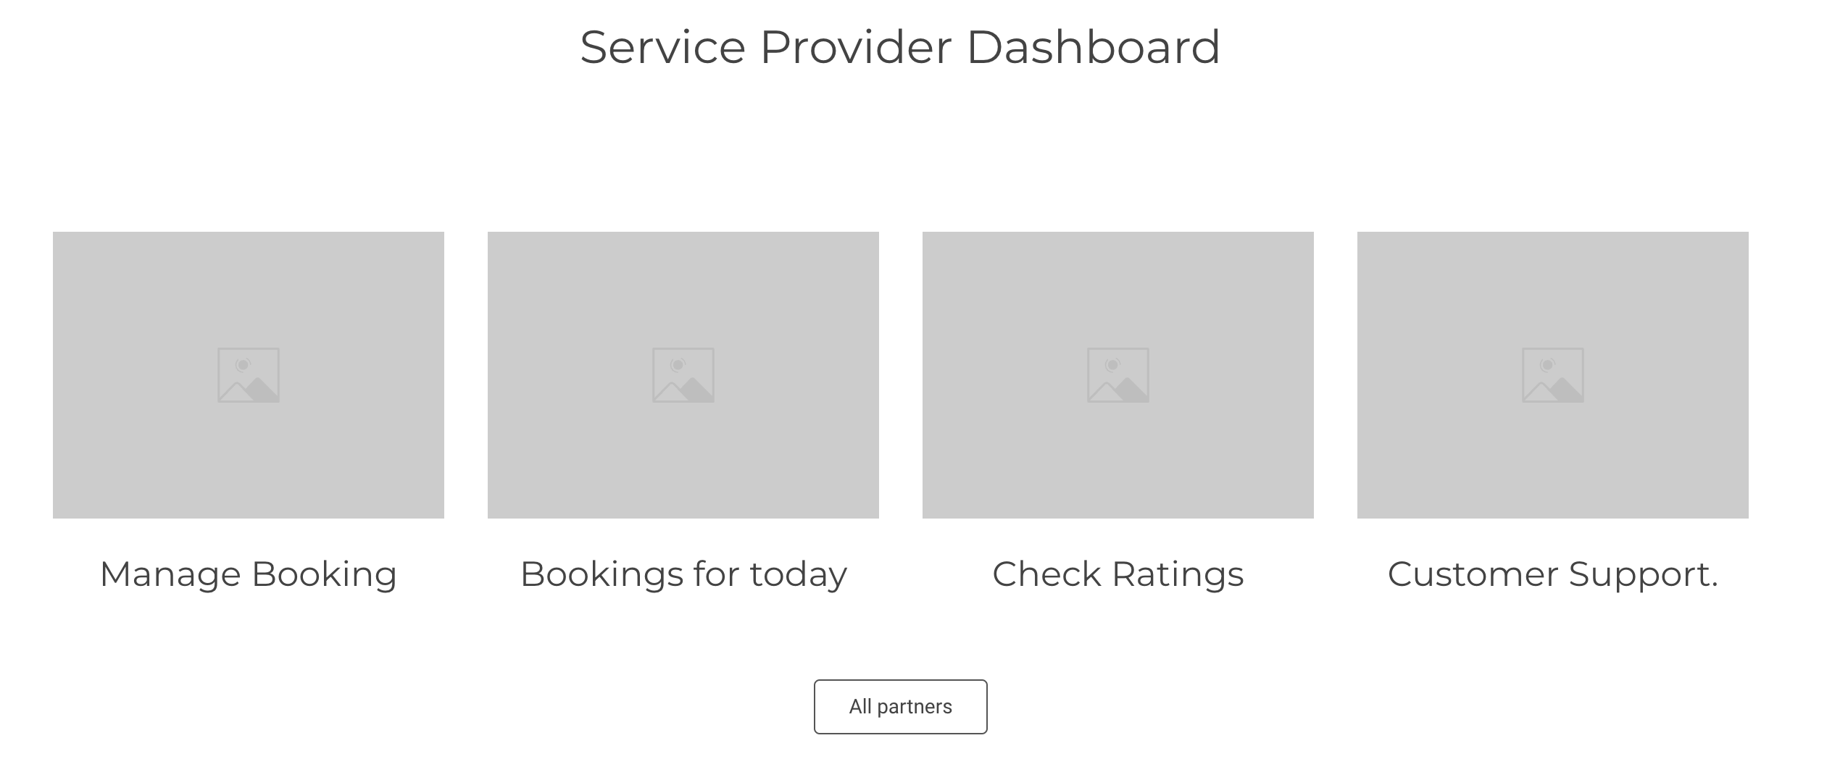
Service Provider’s Dashboard

Slide 7
Support
User contacts customer support team for any query or assistance required.
The customer support team is in charge of responding to customer or service provider inquiries.
When a technical issue arises, the customer support team creates a ticket and tells the product development team. Once the product development team has handled the issue, the customer support team notifies the user that the ticket has been resolved.

